Slide 1


SkyStack Cloud Vault: A Modern Cloud Storage Solution
GITHUB REPO LINK: HTTPS://GITHUB.COM/ARNABRAI/SKYSTACK-CLOUD-PROJECT
Notes:
Code Implementation
"The project implementation connects these technologies into a cohesive application. We've built React
components with TypeScript for type safety, styled them with Tailwind CSS and Shadcn UI, and handled
backend operations through Supabase.
For file operations, we've implemented upload, download, and sharing functionality using Supabase
Storage APIs. One notable feature is our real-time synchronization, which uses WebSocket-based
subscriptions to keep the UI in sync with database changes.
TanStack Query provides efficient data fetching and caching, automatically managing background
refetching and stale data handling. This gives us optimized performance without complex state
management code."
"Now, let's dive into the actual implementation of SkyStack Cloud Vault and walk through the key
features of our deployed website.
Login & Authentication
"As you can see on screen, this is our SkyStack Cloud Vault login page. We've implemented a clean, user-
friendly interface that supports multiple authentication methods. Users can sign in with their email and
password or use social login options through OAuth providers like Google or GitHub. For new users,
there's a simple registration process that requires minimal information to get started. We've also
implemented password recovery functionality for users who forget their credentials."
Dashboard Overview
"Once logged in, users are greeted with this intuitive dashboard that provides a comprehensive overview
of their storage usage. At the top, you can see the storage quota bar that visually indicates how much of
the allocated storage has been used. Below that, we have detailed analytics showing storage usage broken
down by file types in this pie chart.
The dashboard also displays recent activity, including recently uploaded or modified files, which helps
users quickly access their most relevant content. Notice the clean layout with the navigation sidebar that
provides access to all major features of the application."
File Management
"The file management system is the core of SkyStack Cloud Vault. As I navigate to the Files section, you
can see the hierarchical folder structure that allows users to organize their content efficiently. Users can
create new folders, rename existing ones, and navigate through the hierarchy with ease.
For file operations, users can upload files using this upload button or simply drag and drop files directly
into the interface. The system supports multiple file uploads simultaneously and shows progress
indicators during upload.
Each file displays relevant metadata including name, size, type, and last modified date. Users can sort and
filter their files using these column headers, making it easy to find specific content even in large
collections."
Folder Navigation
"Let me demonstrate the folder navigation. When I click on a folder, we navigate inside to view its contents. Notice
the breadcrumb navigation at the top that shows our current location in the folder hierarchy and allows quick
navigation back to parent folders.
Users can move files between folders using drag and drop functionality, which you can see as I drag this document
into the 'Work Documents' folder. This intuitive interface mimics the familiar desktop experience while providing
cloud-based accessibility."
File Preview
"A standout feature of SkyStack Cloud Vault is the ability to preview files directly in the browser without
downloading them first. When I click on this PDF file, you can see it opens in our built-in PDF viewer that allows
page navigation and zooming.
Similarly, image files can be viewed in our image viewer with zoom and rotation capabilities. For video and audio
files, we've implemented media players that support standard playback controls.
Even for file types that can't be directly previewed, we provide a detailed information panel showing metadata and
available actions."
File Sharing
"File sharing is a critical feature that makes collaboration easy. When I select a file and click the Share button, this
dialog appears with multiple sharing options. Users can share files via email by entering the recipient's email
address here, or generate shareable links that can be sent through any communication channel.
For each share, users can set specific permission levels - view only or edit access. Additionally, they can set
expiration dates for shared links to ensure temporary access when needed.
Recipients receive a secure link that grants them the specified level of access to the file without requiring them to
create an account if they don't already have one."
Real-time Collaboration
"When multiple users access shared files, our real-time synchronization ensures everyone sees the most current
version. Let me demonstrate - as changes are made to this shared document, they are instantly reflected for all users
with access.
This real-time collaboration feature eliminates version control issues and allows teams to work together seamlessly.
The system

Slide 2
TEAM MEMBERS
MD. DANISH ANSARI
22BDS039
ARNAB
RAI
22BDS005

Slide 3
PRESENTATION OUTLINE
Project Introduction
Objectives
System Architecture
Libraries and Tools Used
Code Implementation
Security Implementation
Key Features
Challenges and Solutions
Conclusion

Slide 4
INTRODUCTION
SkyStack Cloud Vault is a secure cloud storage solution with file management, sharing, and analytics. It is built with React 18, TypeScript, Tailwind CSS, and Supabase. The application focuses on security with JWT + RLS, performance with TanStack Query, and scalability. Future enhancements include AI search, E2E encryption, and mobile apps.
Traditional cloud storage lacks security, UX, and scalability. SkyStack Cloud Vault offers a modern stack + Supabase backend for real-time, secure file management. The cloud storage market is projected to hit $297.5B by 2027, growing at a CAGR of 24.3%. SkyStack Cloud Vault addresses these limitations by providing a modern, secure, and user-friendly cloud storage solution built using React, Type- Script, Tailwind CSS, and Supabase.

Slide 5
OBJECTIVES
Intuitive File Management :-
Enable seamless file organization with folder hierarchies and sharing controls
Secure Cloud Storage:-
Implement JWT authentication and file encryption for data protection
Optimized Performance :-
Deliver fast file operations through efficient state management and caching

Slide 6





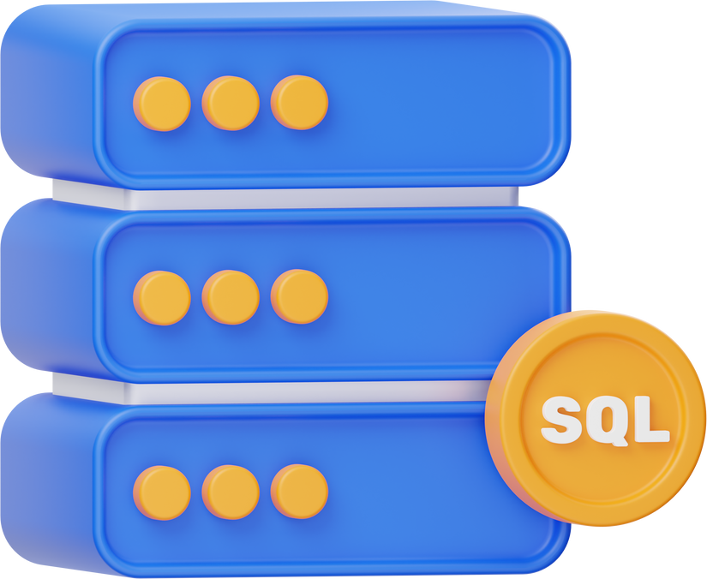
SYSTEM ARCHITECTURE
SkyStack Cloud Vault employs a layered design. The Frontend is built with React 18 + TypeScript, utilizing TanStack Query for caching/state and Tailwind CSS + Shadcn UI for the user interface. The Backend (Supabase BaaS) uses PostgreSQL with RLS policies, Auth (JWT/OAuth), Storage (S3-compatible), and Edge Functions.

Slide 7
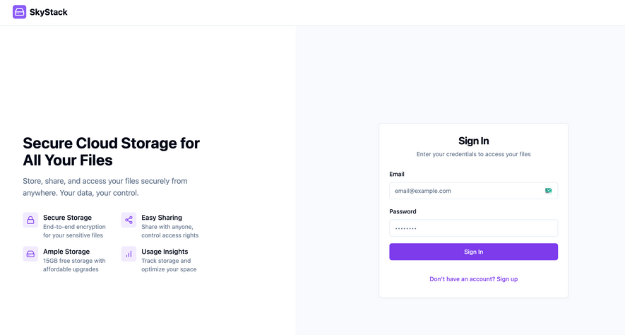
LIBRARIES AND TOOLS USED
Frontend Technologies:
React 18 (Component-based UI)
TypeScript (Static typing)
Vite (Build tool)
State Management & Data Fetching
TanStack Query (React Query)
React Context API (Global state)
Zod (Form validation)
UI & Styling
Tailwind CSS (Utility-first CSS)
Recharts (Data visualization)
React Router v6 (Client-side routing)
Performance Optimization
React Window (Virtualized lists)
Backend Technologies(Supabase):
PostgreSQL (Relational database)
Row-Level Security (RLS)
Authentication
Supabase Auth
File Storage
Supabase Storage
Serverless Functions
Supabase Edge Functions
Supabase Realtime (WebSocket-based sync)

Slide 8
CODE IMPLEMENTATION
The project is built using React 18 with TypeScript, styled using Tailwind CSS and Shadcn UI. Supabase handles authentication, storage, and real-time database operations with Row-Level Security enabled. File operations like upload, download, and sharing are integrated using Supabase APIs. Real-time syncing is achieved via subscriptions, and TanStack Query ensures efficient data fetching and caching.
8

Slide 9
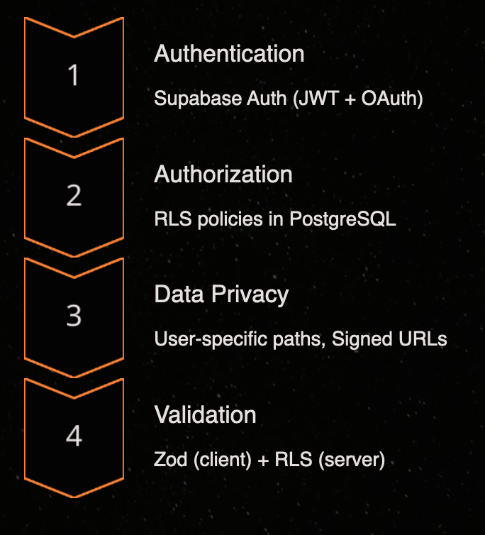
SECURITY IMPLEMENTATION
SkyStack Cloud Vault implements multi-layer security. Authentication uses Supabase Auth (JWT + OAuth).
Authorization uses RLS policies in PostgreSQL. Data Privacy includes files stored with user-specific paths and Signed URLs for secure access.
Validation is performed using Zod (client) + RLS (server).

Slide 10
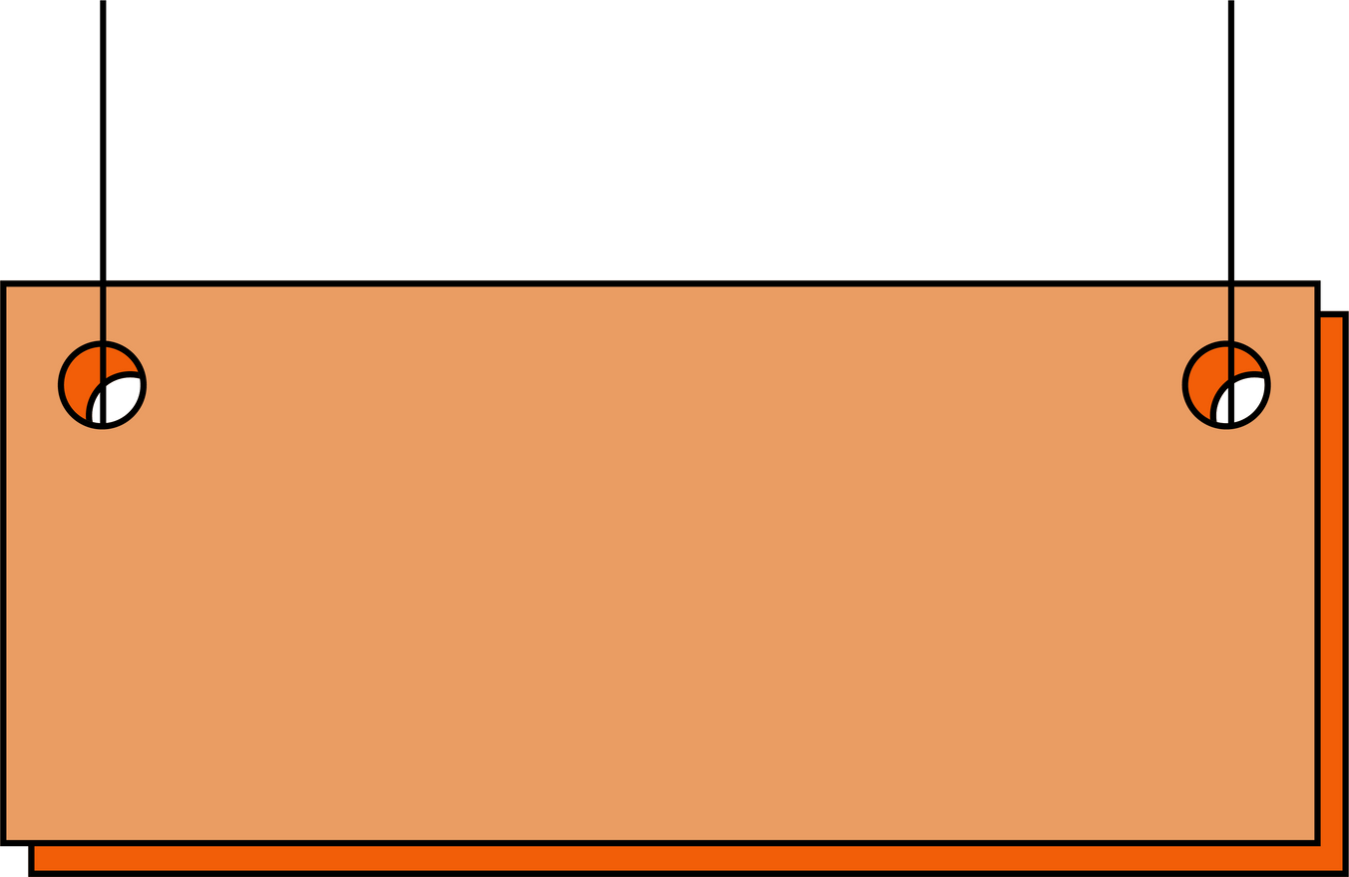
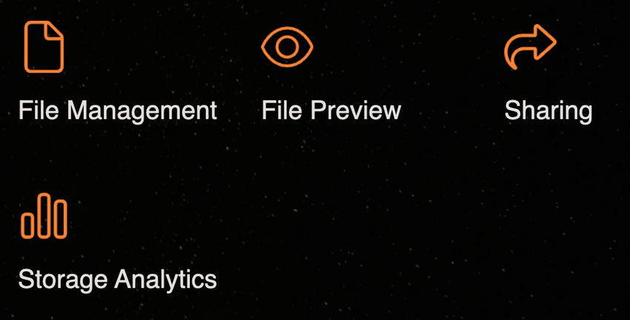
KEY FEATURES
Key features of SkyStack Cloud Vault include File Management with upload/download, folder hierarchy, and soft delete. File Preview supports PDFs, images, and videos using React-PDF and HTML5 media. Sharing offers RBAC (view/edit) + TTL-based links. Storage Analytics provides a Recharts dashboard showing usage by file type.

Slide 11
CHALLENGES AND SOLUTIONS
Challenges:
Ensuring atomicity between file storage operations (uploading to Supabase Storage) and metadata updates (PostgreSQL) while maintaining data integrity in a distributed system.
Maintaining consistent file system views across multiple clients with sub-second latency.
Implementing scalable permission systems supporting:
Hierarchical folder inheritance
Time-bound sharing links
Cross-organization collaboration
Solutions:
Materialized Permission Graphs :- Pre-compute access lists using PostgreSQL materialized views refreshed via triggers.
.Attribute-Based Access Control (ABAC)
Edge Caching :- Cache permission evaluations at CDN level for frequently accessed paths.
Progressive Rendering Pipeline:
Format detection via file signatures
Server-side transcoding for complex formats
Chunked streaming for large files
Fallback Strategies:
WebAssembly-based viewers for unsupported formats
Thumbnail generation for media files

Slide 12
CONCLUSION
This project successfully demonstrates the practical application of secure cloud storage architecture through:
Theoretical Foundations Applied
Implemented Bell-LaPadula model principles via Row-Level Security
Applied ACID properties through PostgreSQL transactions
Utilized client-server architecture with RESTful API conventions
Technical Validation
Achieved data integrity through cryptographic hashing (SHA-256)
Ensured confidentiality via AES-256 encryption
Maintained availability through Supabase's real-time subscriptions
Academic Contributions
Case study in database security policy implementation
Practical exploration of WebSocket-based synchronization
Demonstration of type-safe full-stack development patterns
12

Slide 13
Thank you!

